Slide 1


Update
Olivier Bergeron

Slide 2

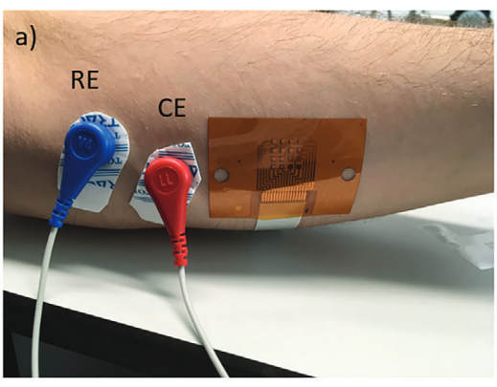
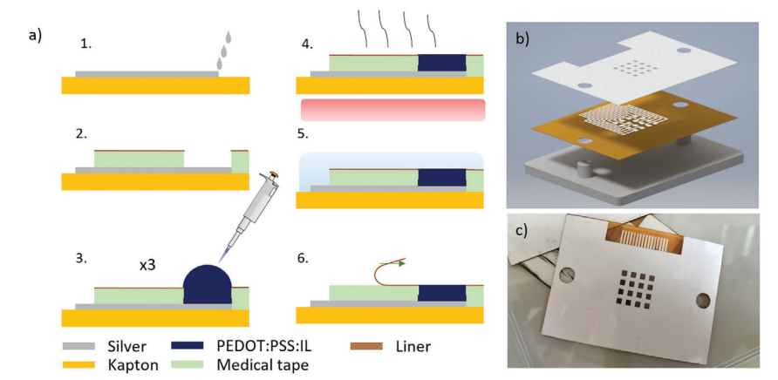
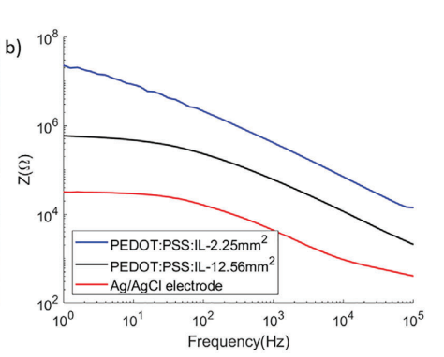
PEDOT article no 1
Conducting Polymer-Ionic Liquid Electrode Arrays for High-Density Surface Electromyography (Velasco-Bosom et al.)
Key points
Grid size: 4 x 4
Electrode size: 1.5 mm x 1.5 mm
IED: 3 mm
Scalable fabrication techniques

Slide 3
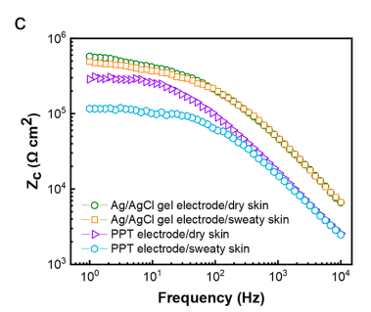
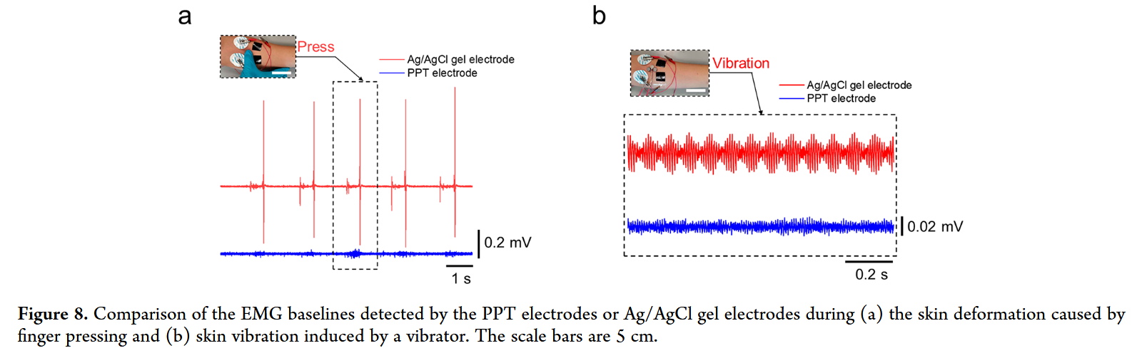
PEDOT article no 2
Stretchable and Self-Adhesive PEDOT:PSS Blend with High Sweat Tolerance as Conformal Biopotential Dry Electrodes (Cao et al.)
Key points
Blend of PEDOT, Polyvinyl alcohol and tannic acid
Lower peak noise than Ag/AgCl (20 µV vs 60 µV)
Stretchable with minimal resistance change (up to 50% stretch)
Self-adhesive on dry and sweaty skin

Slide 4
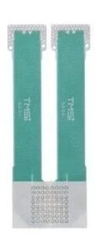
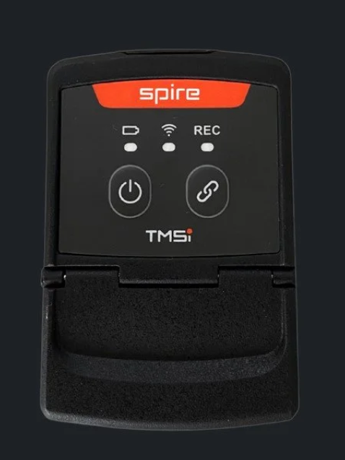
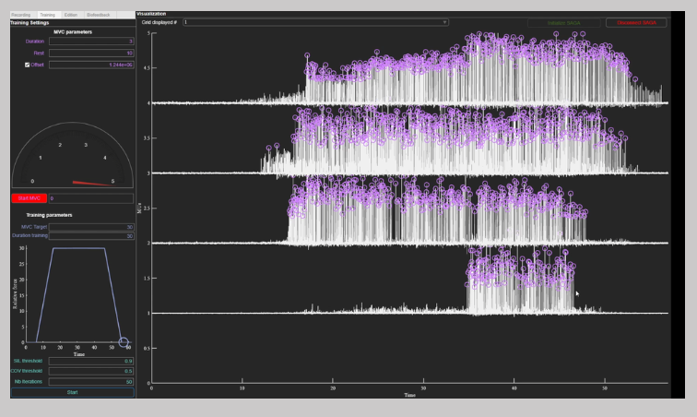
Pre-made kits - TMSi
Electrode grid
4 mm IED
2 mm diameter (not written but assumed)
32 and 64 channels available
Textile grids
Wireless acquisition module
Free software
Motor unit decomposition

Slide 5
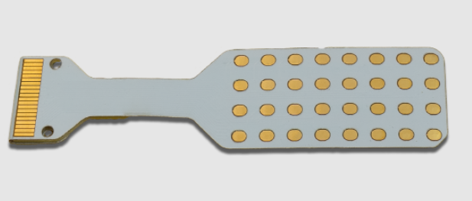
Pre-made kits - Ot Bioelettronica
Electrode Grid
5 mm IED
2.5 mm diameter (not written but assumed)
32 channels available
Acquisition module
High channel count available (384 or 960)

Slide 6
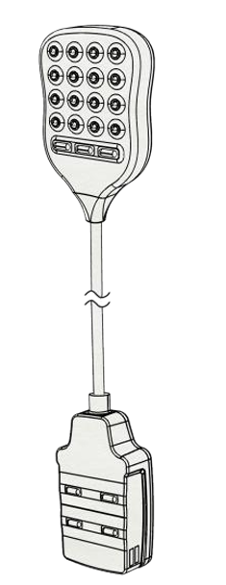
Pre-made kits - Delsys
Electrode grid
2 mm diameter
6 mm IED
Hard to generate bigger grid
Paid software
API available
Motor Unit Decomposition

Slide 7
Explorable solution
Main issue: acquisition modules very expensive
Possible solution: Custom made acquisition system
Could be tested with commercial grid

